Slide 1
Agriculture Blockchain/technologies
Computer Science
111062575
許詠晴

Slide 2
Outline
Introduction
Technology Analysis
Industry Analysis
Applications
S.W.O.T
Conclusion
References

Slide 3
Outline
Introduction
What is blockchain
Why to use blockchain in Agricultural sector?
Technology Analysis
Industry Analysis
Applications
S.W.O.T
Conclusion
References

Slide 4
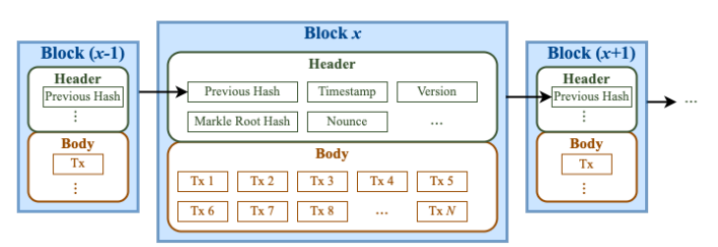
What is blockchain
A blockchain is a type of distributed ledger technology (DLT) that consists of growing list of records, called blocks, that are securely linked together using cryptography.

Slide 5
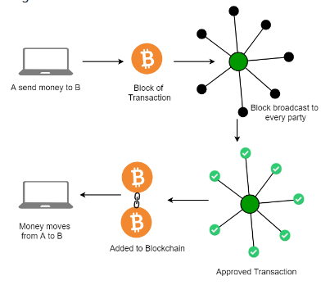
What is blockchain
Blockchains are typically managed by a peer-to-peer (P2P) computer network

Slide 6
What is blockchain
Property of Blockchains:
Data Immutability and Integrity : without the consent from the majority of nodes, no one can add/delete/edit any transaction blocks to the ledger.
Decentralized: not like Client-Server model, managed by P2P network
Transparent: Because every node or participant in Blockchain can access to all transaction data.
Consensus-based: Every blockchain thrives because of the consensus algorithms.
Flexible: Smart Contract

Slide 7
Why to use blockchain in Agricultural sector?
Food safety issues
Data Immutability and Integrity
Transparent
Food supply chain may be traceable
Smart farming
track the provenance of food
trustworthy food supply chains
build trust between producers and consumers
facilitates the use of data-driven technologies to make farming smarter
More application
Trustworthy platform

Slide 8
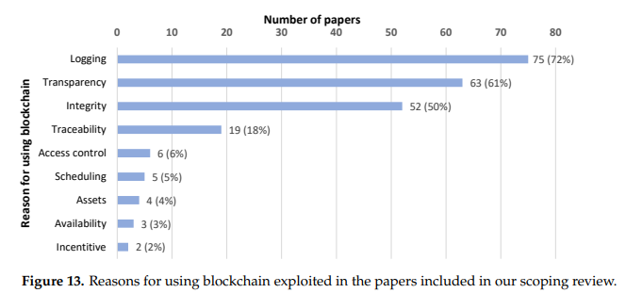
Why to use blockchain in Agricultural sector?
Source: Andreas Sendros et al: Blockchain Applications in Agriculture: A Scoping Review

Slide 9
Outline
Introduction
Technology Analysis
How blockchain works
Types of blockchain
IOT and IPFS
Industry Analysis
Applications
S.W.O.T
Conclusion
References

Slide 10
How blockchain works
Cryptography
Consensus: a mechanism for adding new blocks into the blockchain
Smart contracts
P2P network

Slide 11
Cryptography
A method of securing data from unauthorized access.
Symmetric-Key cryptography
Asymmetric-Key Cryptography
Hash Functions
example of an SHA-256 hash function
Input: hello my friend
Output: 5d575bc10fbfbf62435849d4f8d0382a5acc939e9f92492d87e70852655d8be9
Input with a slight difference: hello my friend!
Output: 7f254266b011eec22f0af99bf627143bab758ae5eb840fffb87e5d24850f1320

Slide 12
Consensus
A method of authenticating and validating a value or transaction on a Blockchain or a distributed ledger without the need to trust or rely on a central authority.
Consensus mechanisms are central to the functioning of any blockchain or distributed ledger.
PoW, PoS, DPoS
PBFT, PoET

Slide 13
Consensus
POW
Miners bundle up a group of transactions into a block and try to mine it (try to solve hard puzzle)
Hard puzzle defines:
Given data A, find a number x such as that the hash of x appended to A results is a number less than B.
The first problem-solving miner add this block into the blockchain and broadcast this new block to every nodes

Slide 14
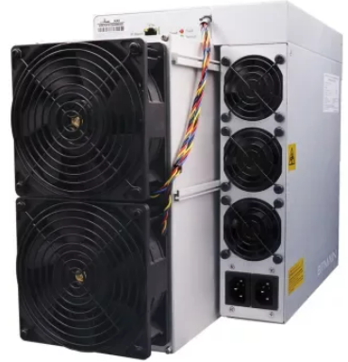
Consensus
Mining ASIC
Bitmain Antminer KA3 (166Th)
Manufacturer | Bitmain
Model | Antminer KA3 (166Th)
Release | September 2022
Hashrate | 166Th/s
Size | 195 x 290 x 430mm
Weight | 16100g
Noise level | 80db
Fan(s) | 4
Power | 3154W
Voltage | 200-240V
Interface | Ethernet
Temperature | 5 - 40 °C
Humidity | 10 - 90 %
Hashrate: 166Th/s
Power consumption: 3154W
Interface type: PCIE 3.0 16X
VARM: >= 2GB (DDR5)

Slide 15

Consensus
Mining GPU
Nvidia
Geforce RTX 3080 Ti
15.24Gh/s hashrate | Hash rate
12 GB GDDR6X | VRAM
8nm | Process size

Slide 16
Consensus
POS
The system randomly pick up a validators who confirm transactions and validate block information.
Probability(Coin age) of being selected
Coin age = days of coin stack * number of stack coins
In Ethereum, Blocks are validated by more than one validator, and when a specific number of the validators verify that the block is accurate, it is finalized and closed.

Slide 17
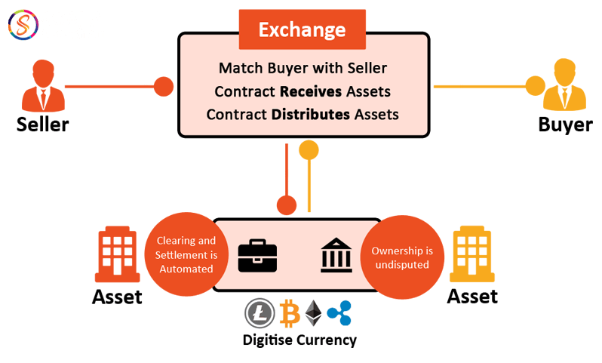
Smart contracts
Smart contracts are simply programs stored on a blockchain that run automatically when predetermined conditions are met.
DApp (decentralized application) is an combination of a series of smart contracts.
Source: https://www.scalablockchain.com/smartcontract.html

Slide 18
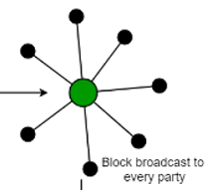
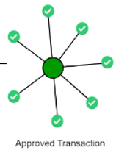
How blockchain works
based on P2P
User A
request
Transfer money
(or deploy smart contracts)
Through consensus algo.
the request is broadcast to every node
the request is packaged together with others request into a block.
request of user A is completed.
the block is linked to the blockchain

Slide 19
Types of blockchain
Public blockchain
Private blockchain
Consortium blockchain

Slide 20
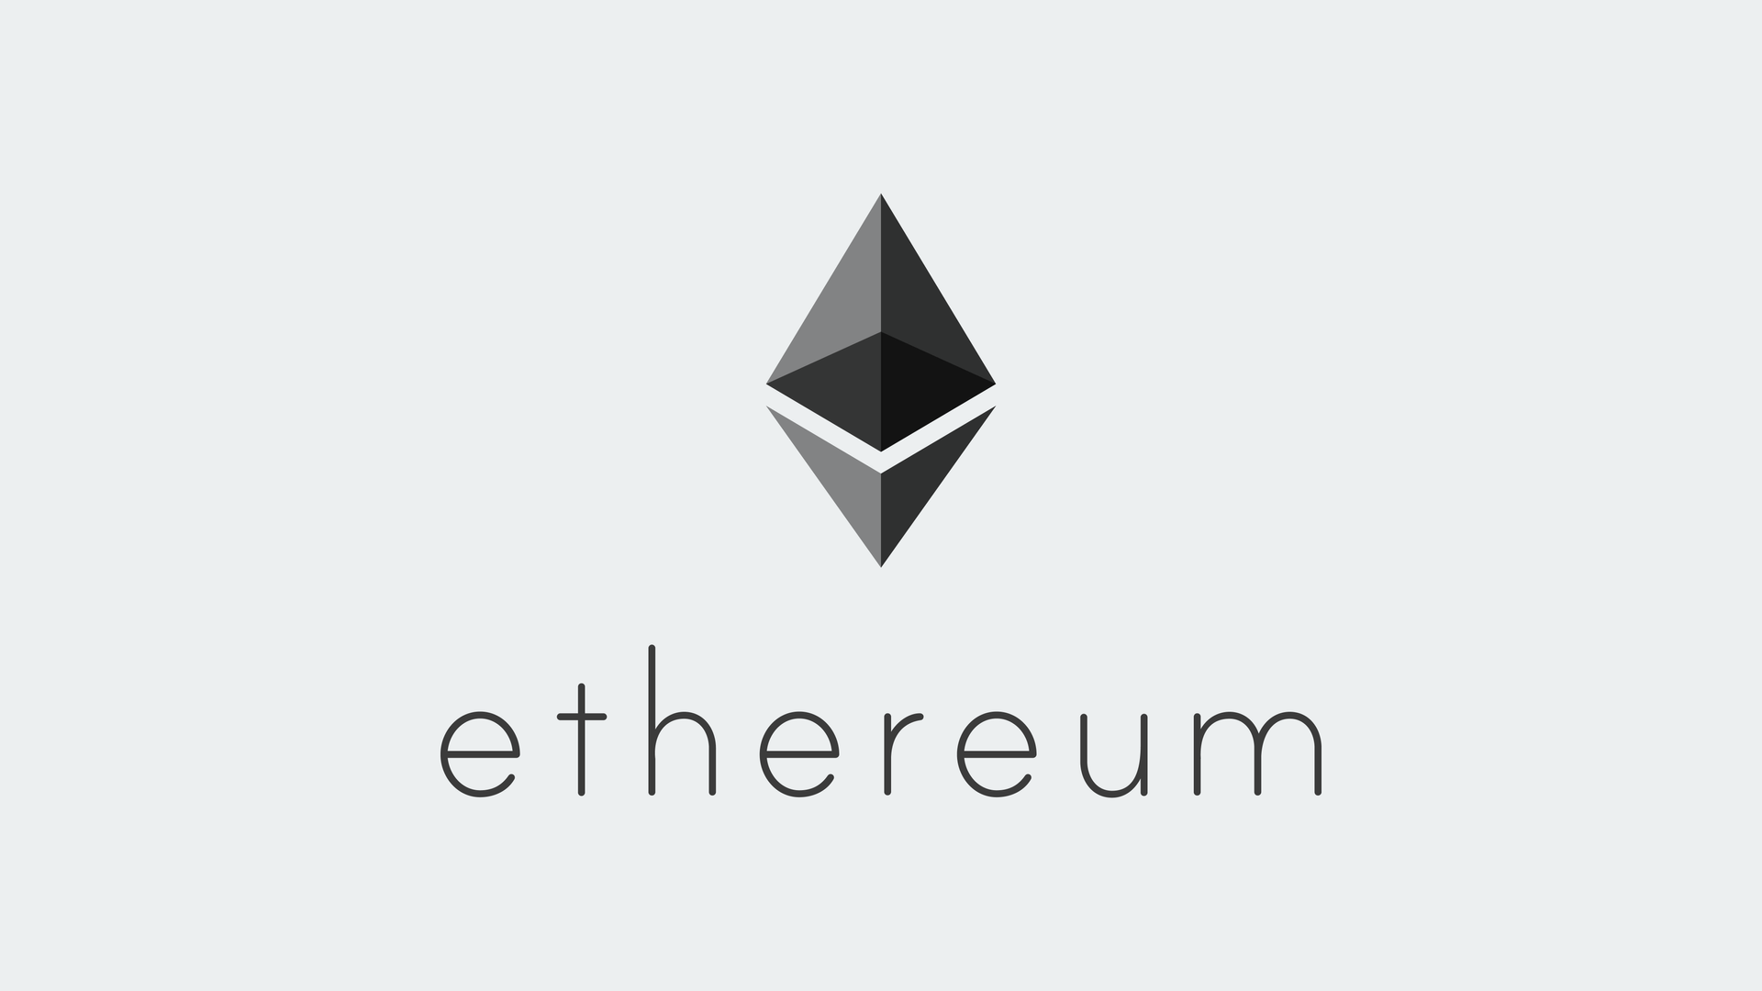

Public blockchain
It is a permissionless distributed ledger on which anybody can join and conduct transactions.
Public Blockchain nodes do not need to know or trust each other, so consensus mechanism is often complexity, such as PoW, PoS, and so on.
Open and transparent: data on a public blockchain is transparent to all member nodes.

Slide 21
Private blockchain
A blockchain network operates in a private context, such as a restricted network, or is controlled by a single identity.
it has a similar peer-to-peer connection and decentralization to a public blockchain network.
They are often run on a small network within a firm or organization rather than open to anybody who wants to contribute processing power.

Slide 22
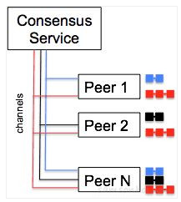
Consortium blockchain
A consortium blockchain is a combination of multiple private blockchains belonging to different organizations.
each organization manages their own node or blockchain, the data within can be accessed, shared and distributed by organizations within the consortium.
Hyperledger Fabric was designed for enterprise use.
Source: https://www.samsonhoi.com/661/blockchain-hyperledger-fabric

Slide 23
IOT and IPFS
IOT in agriculture
IPFS
IOT data with blockchain and IPFS

Slide 24
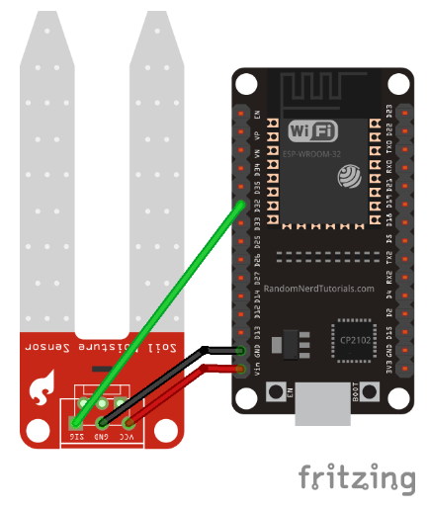
IOT in agriculture
Soil Moisture Data Retrieval using using Tuya Link SDK
Source: https://opencloudware.com/soil-moisture-data-retrieval-application-using-tuya-link-sdk/

Slide 25
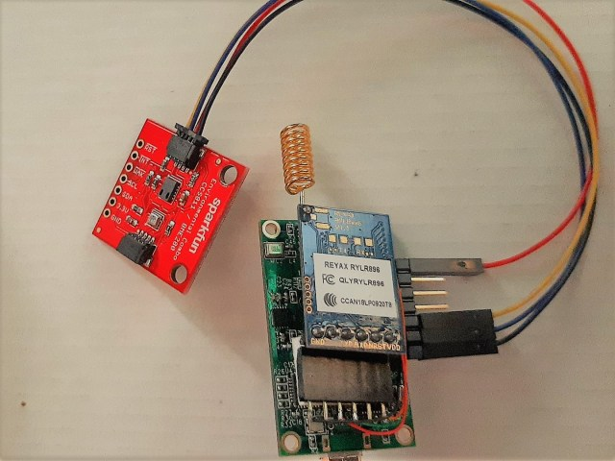
IOT in agriculture
Himax WE-I Plus EVB Endpoint AI Development Board with SparkFun’s Qwiic sensors on farms
LoRa:
is a physical proprietary radio communication te-chnique
Sensors:
TVOC
eCO2
Temperature
Humidity
pressure
Himax WE-I Plus:
The ML model used in this application is for basic crop detection.
Source:https://opencloudware.com/smart-agriculture-application-using-himax-we-i-plus-evb-endpoint-ai-development-board/

Slide 26
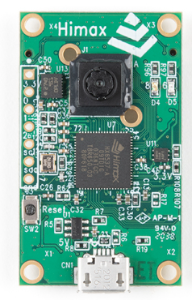
IOT in agriculture
Himax WE-I Plus EVB Endpoint AI Development Board
WE-I Plus ASIC (HX6537-A)
ARC 32-bit EM9D DSP with FPU
400MHz clock frequency
2MB SRAM
2MB Flash
Himax HM0360 AoS TM ultra-low power VGA CCM
1/6" CMOS Sensor
640 x 480 Pixel
60 FPS
FTDI USB to SPI/I2C/UART bridge
LDO power supply (3.3/2.8/1.8/1.2V)
3-axis accelerometer (STM LSM9DS1)
1x reset button
2x microphones (L/R)
2x user LEDs
MicroUSB connector
Expansion header
1x I2C port
3x GPIOs
Power/Ground
Source:https://opencloudware.com/smart-agriculture-application-using-himax-we-i-plus-evb-endpoint-ai-development-board/

Slide 27
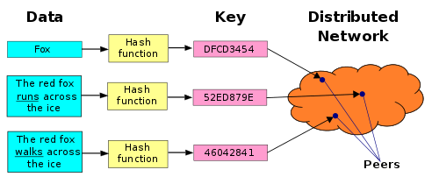
IPFS
The InterPlanetary File System (IPFS) is a protocol, hypermedia and file sharing peer-to-peer network for storing and sharing data in a distributed file system.
IPFS uses content-addressing to uniquely identify each file in a global namespace connecting IPFS hosts.
Content of each file
Hash value
Source:https://en.wikipedia.org/wiki/Distributed_hash_table

Slide 28
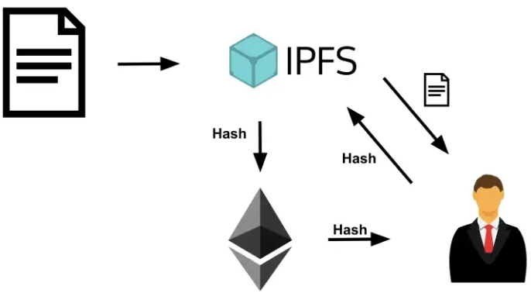
IOT data with blockchain and IPFS
IOT data is too large that is hard to put them all into blockchain.
Thus, IOT data usually store into IPFS File System.
Get the hash value of IOT data file, then store it into blockchain. And, other user can get the hash value from the blockchain and get the IOT data.
Source:https://medium.com/pinata/ethereum-and-ipfs-e816e12a3c59

Slide 29
Outline
Introduction
Technology Analysis
Industry Analysis
Applications
S.W.O.T
Conclusion
References

Slide 30
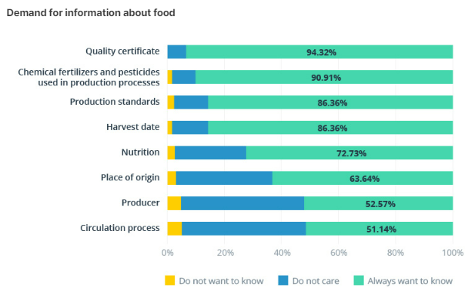
Industry Analysis
Source: Consumer Preferences for Traceable Food

Slide 31
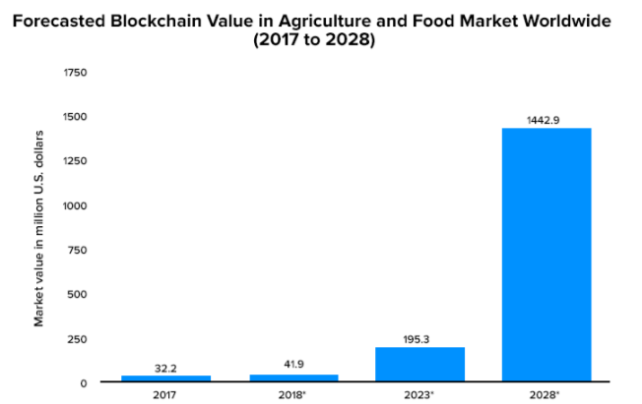
Industry Analysis
Source: Worldwide; BIS Research; 2021

Slide 32
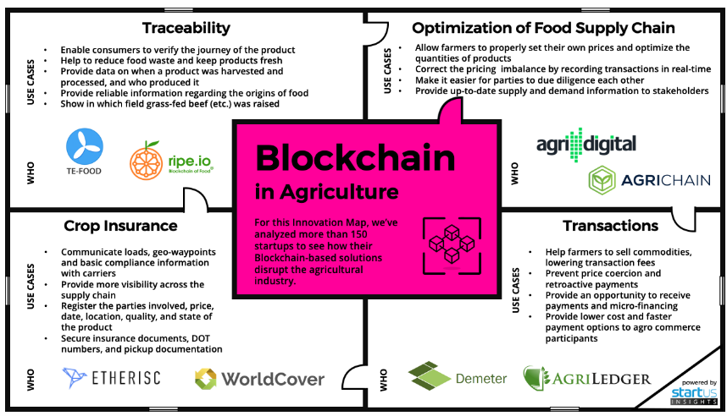
Industry Analysis
Source: StartUs insights

Slide 33
Outline
Introduction
Technology Analysis
Industry Analysis
Applications
S.W.O.T
Conclusion
References

Slide 34
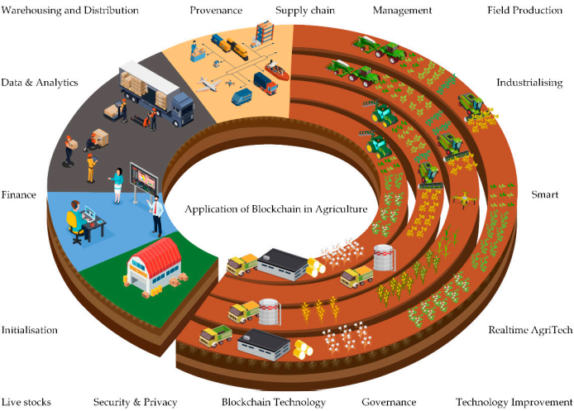
Applications

Slide 35
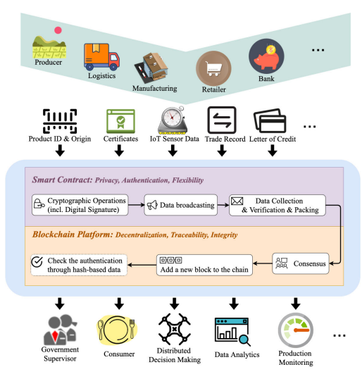
Applications
Source: W. Lin et al.: Blockchain Technology in Current Agricultural Systems

Slide 36
Applications
Product quality control
Improving supply chains
AgTech IoT-optimization
Fair pricing
Crowdfunding of agricultural production
Small Farm Insurance
Corporate Responsibility

Slide 37
Outline
Introduction
Technology Analysis
Industry Analysis
Applications
S.W.O.T
Conclusion
References

Slide 38
S.W.O.T
Strengths:
Transparency, immutable and integrity
Can be more trustable and traceable
help solve various security issues
Weakness:
Still develop
It is not always clear why blockchain is used and the security issues
it solves.
Opportunity:
still develop
Everything is possible.
Threat:
The scandal of some blockchain relative organizations/companies
Traditional agriculture

Slide 39
Outline
Introduction
Technology Analysis
Industry Analysis
Applications
S.W.O.T
Conclusion
References

Slide 40
Conclusion
It is a clear trend that integrating new technologies in the traditional agricultural sector.
However, the field is still in its infancy and most of the solutions are conceptual.
Traceability, optimization of food supply chain, crop insurance and transactions may be the four directions of future development.

Slide 41
Outline
Introduction
Technology Analysis
Industry Analysis
Applications
S.W.O.T
Conclusion
References

Slide 42
Reference
Blockchain Technology in Current Agricultural Systems: From Techniques to Applications (https://ieeexplore.ieee.org/document/9159588)
Survey on the Applications of Blockchain in Agriculture (https://www.researchgate.net/publication/363068991_Survey_on_the_Applications_of_Blockchain_in_Agriculture)
Blockchain Applications in Agriculture: A Scoping Review (https://www.researchgate.net/publication/360417397_Blockchain_Applications_in_Agriculture_A_Scoping_Review )
What is Hyperledger Fabric? (https://www.ibm.com/topics/Hyperledger )
Blockchain from Wikipedia (https://en.wikipedia.org/wiki/Blockchain )

Slide 43
Reference
【IPFS 技術佈道人】入門淺談：什麼是 IPFS？ (https://blockcast.it/2019/10/16/let-me-tell-you-what-is-ipfs/ )
Introduction to Blockchain technology | Set 1 (https://www.geeksforgeeks.org/blockchain-technology-introduction/ )
Blockchain Technology for Agriculture: Applications and Rationale (https://www.frontiersin.org/articles/10.3389/fbloc.2020.00007/full )
Blockchain Technology in Agriculture (https://www.edengreen.com/blog-collection/blockchain-technology-in-agriculture )
Food system jobs (https://www.worldbank.org/en/topic/food-system-jobs )

Slide 44
Reference
The Complete Guide for Types of Blockchain! (https://www.simplilearn.com/tutorials/blockchain-tutorial/types-of-blockchain )
區塊鏈 Blockchain – Hyperledger Fabric
(https://www.samsonhoi.com/661/blockchain-hyperledger-fabric )

